Slide 1
Data Encoding Techniques

Slide 2
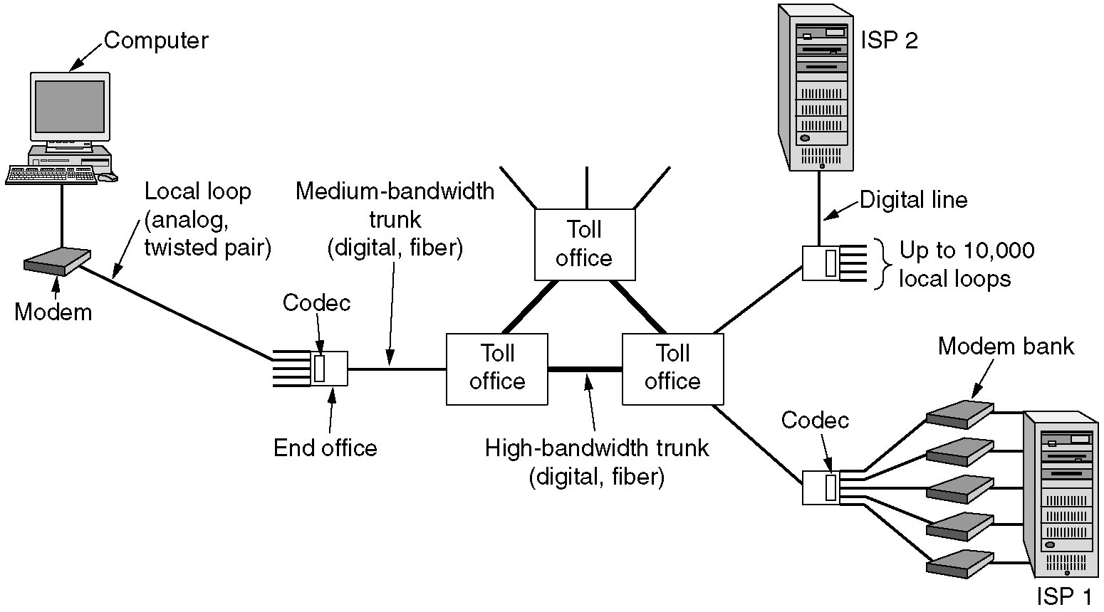
Analog and Digital Transmissions
Figure 2-23.The use of both analog and digital transmissions for a computer to computer call. Conversion is done by the modems and codecs.
Networks: Data Encoding

Slide 3
Data Encoding Techniques
Digital Data, Analog Signals [modem]
Digital Data, Digital Signals [wired LAN]
Analog Data, Digital Signals [codec]
  Frequency Division Multiplexing (FDM)
  Wave Division Multiplexing (WDM) [fiber]
  Time Division Multiplexing (TDM)
  Pulse Code Modulation (PCM) [T1]
  Delta Modulation
Networks: Data Encoding

Slide 4
Digital Data, Analog Signals
[Example – modem]
Basis for analog signaling is a continuous, constant-frequency signal known as the carrier frequency.
Digital data is encoded by modulating one of the three characteristics of the carrier: amplitude, frequency, or phase or some combination of these.
Networks: Data Encoding

Slide 5
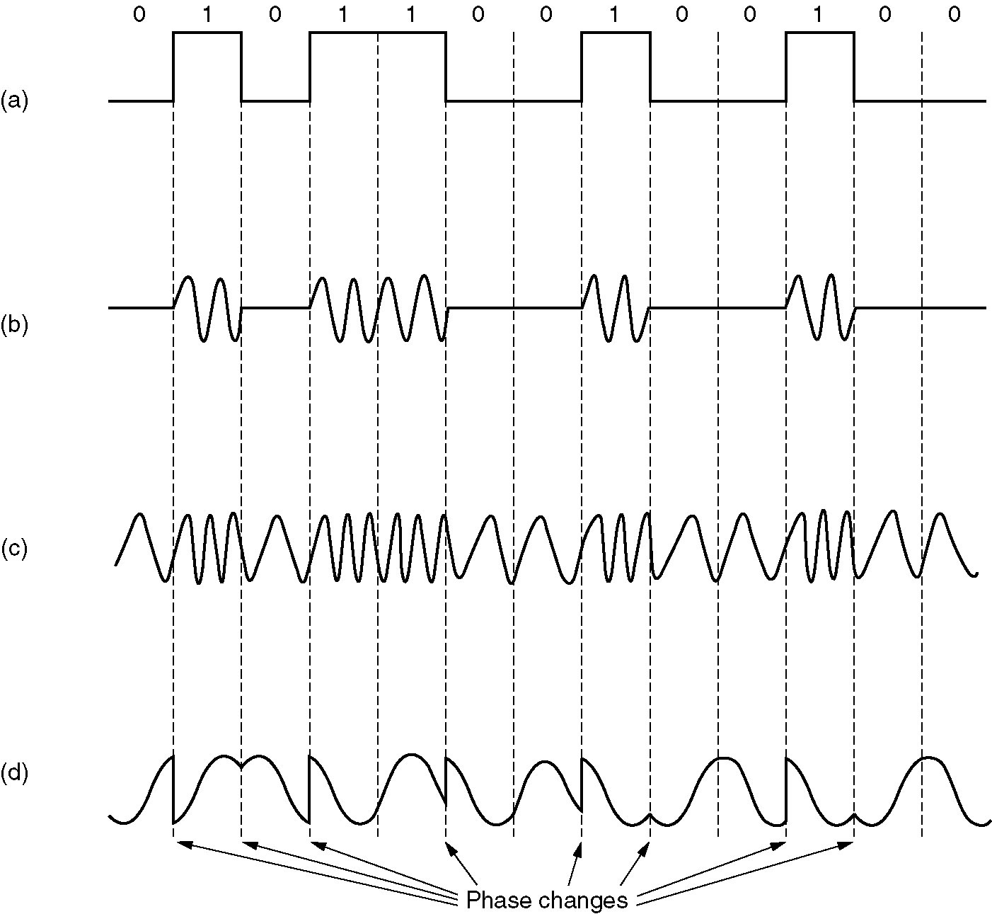
A binary signal
Amplitude
modulation
Frequency
modulation
Phase modulation
Figure 2-24.
Networks: Data Encoding

Slide 6
Digital Data, Digital Signals
[the technique used in a number of LANs]
Digital signal – is a sequence of discrete, discontinuous voltage pulses.
Bit duration :: the time it takes for the transmitter to emit the bit.
Issues
  Bit timing
  Recovery from signal
  Noise immunity
Networks: Data Encoding

Slide 7
NRZ ( Non-Return-to-Zero) Codes
Uses two different voltage levels (one positive and one negative) as the signal elements for the two binary digits.
NRZ-L ( Non-Return-to-Zero-Level)
The voltage is constant during the bit interval.
NRZ-L is used for short distances between terminal and modem or terminal and computer.
⬄ negative voltage
0 ⬄ positive voltage
Networks: Data Encoding

Slide 8
NRZ ( Non-Return-to-Zero) Codes
NRZ-I ( Non-Return-to-Zero-Invert on ones)
The voltage is constant during the bit interval.
NRZI is a differential encoding (i.e., the signal is decoded by comparing the polarity of adjacent signal elements.)
1 ⬄ existence of a signal transition at the beginning of the bit time
(either a low-to-high or a high-to-low transition)
0 ⬄ no signal transition at the beginning of the bit time
Networks: Data Encoding

Slide 9
Bi –Phase Codes
Bi- phase codes – require at least one transition per bit time and may have as many as two transitions.
➔ the maximum modulation rate is twice that of NRZ ➔ greater transmission bandwidth is required.
Advantages:
Synchronization – with a predictable transition per bit time the receiver can “synch” on the transition [self-clocking].
No d.c. component
Error detection – the absence of an expected transition can used to detect errors.
Networks: Data Encoding

Slide 10
Manchester encoding
There is always a mid-bit transition {which is used as a clocking mechanism}.
The direction of the mid-bit transition represents the digital data.
Consequently, there may be a second transition at the beginning of the bit interval.
Used in 802.3 baseband coaxial cable and CSMA/CD twisted pair.
1 ⬄ low-to-high transition
0 ⬄ high-to-low transition
Textbooks
disagree
on this
definition!!
Networks: Data Encoding

Slide 11
Differential Manchester encoding
mid-bit transition is ONLY for clocking.
Differential Manchester is both differential and bi-phase.
Note – the coding is the opposite convention from NRZI.
Used in 802.5 (token ring) with twisted pair.
* Modulation rate for Manchester and Differential Manchester is twice the data rate ➔ inefficient encoding for long-distance applications.
1 ⬄ absence of transition at the beginning of the bit interval
0 ⬄ presence of transition at the beginning of the bit interval
Networks: Data Encoding

Slide 12
Bi-Polar Encoding
Has the same issues as NRZI for a long string of 0’s.
A systemic problem with polar is the polarity can be backwards.
1 ⬄ alternating +1/2 , -1/2 voltage
0 ⬄ 0 voltage
Networks: Data Encoding

Slide 13
1
0
1
0
1
1
1
0
0
Unipolar
NRZ
Polar NRZ
NRZ-Inverted
(Differential
Encoding)
Bipolar
Encoding
Manchester
Encoding
Differential
Manchester
Encoding
Copyright ©2000 The McGraw Hill Companies
Leon-Garcia & Widjaja: Communication Networks
Figure 3.25

Slide 14
Analog Data, Digital Signals
[Example – PCM (Pulse Code Modulation)]
The most common technique for using digital signals to encode analog data is PCM.
Example: To transfer analog voice signals off a local loop to digital end office within the phone system, one uses a codec.
Because voice data limited to frequencies below 4000 HZ, a codec makes 8000 samples/sec. (i.e., 125 microsec/sample).
Networks: Data Encoding

Slide 15
Multiplexing
(a)
(b)
A
A
A
Trunk
group
A
B
B
B
MUX
MUX
B
C
C
C
C
Copyright ©2000 The McGraw Hill Companies
Leon-Garcia & Widjaja: Communication Networks
Figure 4.1
Networks: Data Encoding

Slide 16
Frequency-division Multiplexing
(a) Individual signals occupy H Hz
A
f
0
H
B
0
f
H
C
f
0
H
(b) Combined signal fits into channel bandwidth
A
B
C
f
Copyright ©2000 The McGraw Hill Companies
Leon-Garcia & Widjaja: Communication Networks
Figure 4.2
Networks: Data Encoding

Slide 17
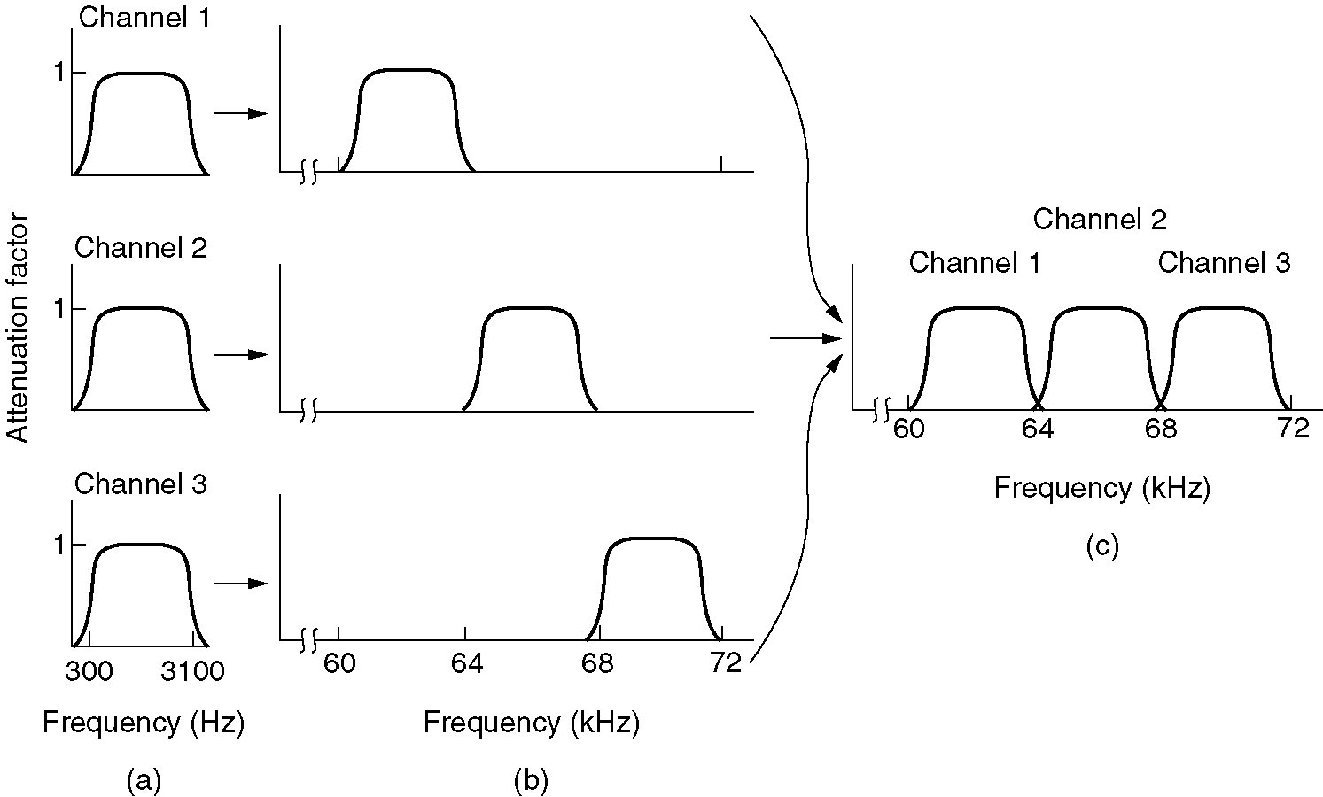
Frequency-division Multiplexing
Figure 2-31. (a) The original bandwidths. (b) The bandwidths raised in frequency. (c) The multiplexed channel.
Networks: Data Encoding

Slide 18
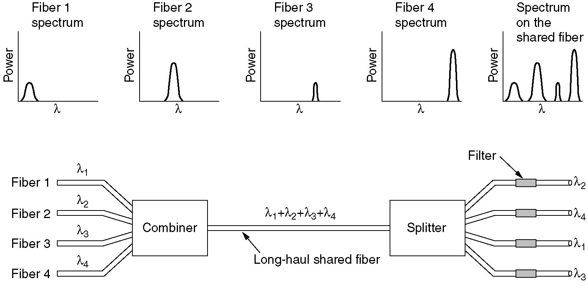
Wavelength Division Multiplexing
Wavelength division multiplexing.
Figure 2-32.
Networks: Data Encoding

Slide 19
Time-division Multiplexing
(a) Each signal transmits 1 unit every 3T seconds
A₁
A₂
t
0T
3T
6T
B₁
B₂
t
0T
3T
6T
C₁
C₂
t
0T
3T
6T
(b) Combined signal transmits 1 unit every T seconds
A₁
B₁
C₁
A₂
B₂
C₂
t
0T 1T 2T 3T 4T 5T 6T
Copyright ©2000 The McGraw Hill Companies
Leon-Garcia & Widjaja: Communication Networks
Figure 4.3
Networks: Data Encoding

Slide 20
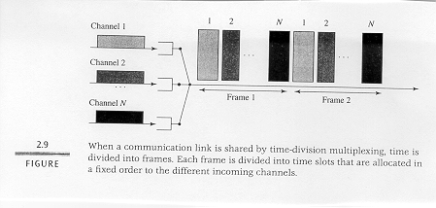
Time-division Multiplexing
Networks: Data Encoding

Slide 21
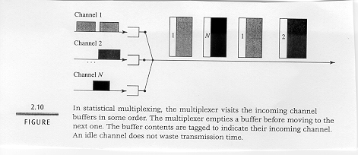
Statistical Multiplexing - Concentrator
Networks: Data Encoding

Slide 22
Delta Modulation (DM)
The basic idea in delta modulation is to approximate the derivative of analog signal rather than its amplitude.
The analog data is approximated by a staircase function that moves up or down by one quantization level at each sampling time. ➔ output of DM is a single bit.
PCM preferred because of better SNR characteristics.
Networks: Data Encoding

Slide 23
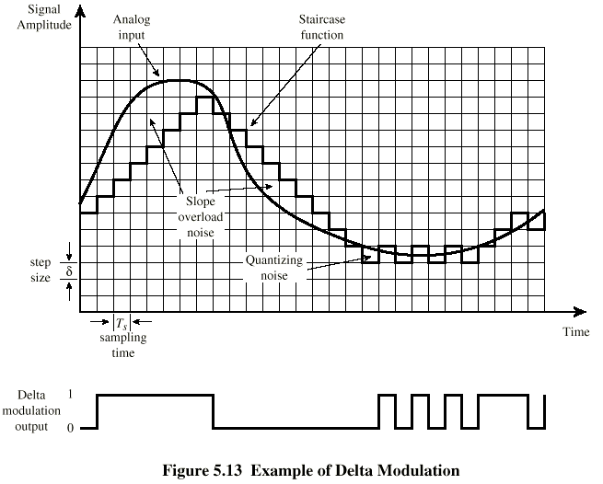
Delta Modulation DCC 6th Ed. W.Stallings
Networks: Data Encoding

